Slide 1

Lesson: Data Types for SQL Server and other Databases
by Lambert, Scott

Slide 2
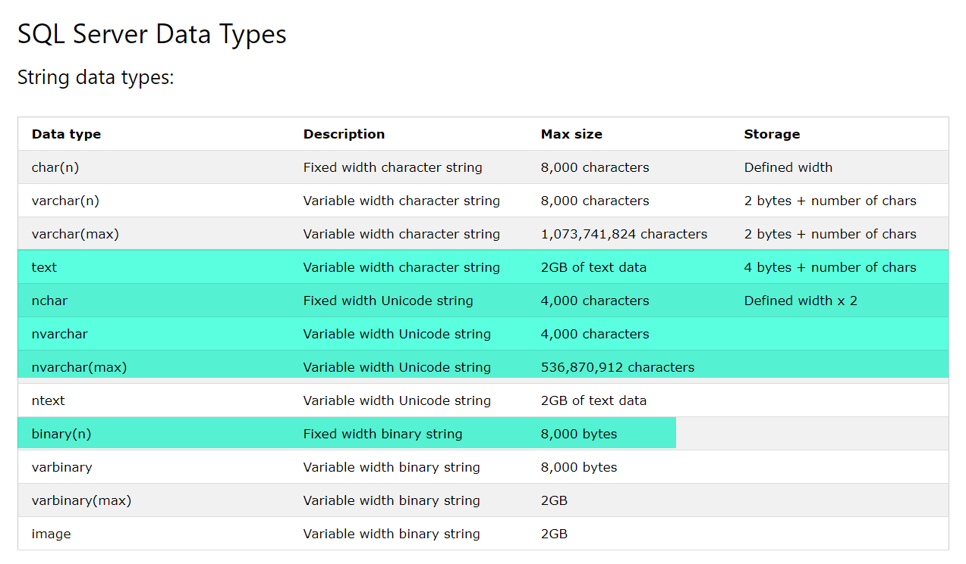

Slide 3
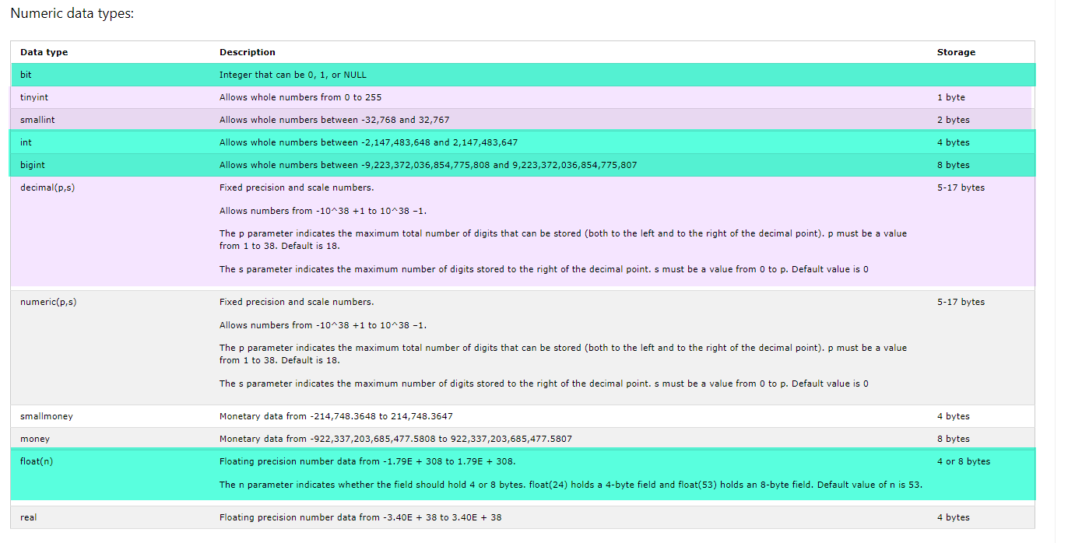

Slide 4
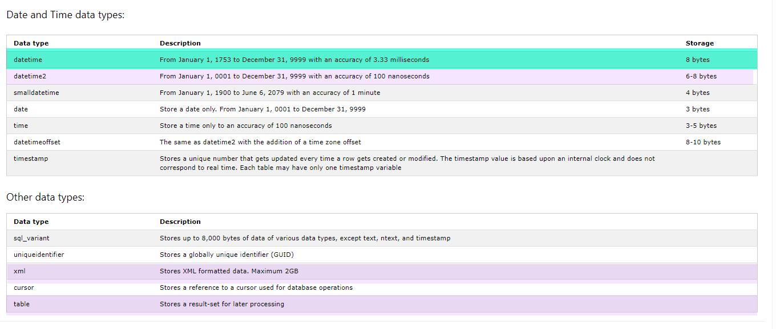

Slide 5
